Slide 1

REAL TIME WIREFRAME-BASED POTHOLE DETECTION AND AVOIDANCE SYSTEM
BATCH - 02
GUIDED BY: DR RG SURESH KUMAR
PRESENTED BY: MOHAMED B SIRAJUDDEEN
BATCH 2
PAGE 1

Slide 2

AGENDA
10
LITERATURE SURVEY
1
DOMAIN
11
LITERATURE SURVEY TABLE
2
SHORT VIDEO
12
PROPOSED SOLUTION
3
ABSTRACT
13
PROPOSED SYSTEM
4
14
OBJECTIVE
PROPOSED SYSTEM ARCHITECTURE
5
INTRODUCTION
15
SYSTEM REQUIREMENT
6
16
EXISTING SYSTEM
ENVIRONMENTAL SETUP
7
17
EXISTING ARCHITECTURE
CURRENT STATUS
8
ADVANTAGES & DISADVANTAGES
18
CONCLUSION
9
PROBLEM STATEMENT
19
REFERENCE
BATCH 2
PAGE 2

Slide 3

DOMAIN and SUB-DOMAIN
ARTIFICIAL INTELLIGENCE
AUTONOMOUS VEHICLES
Encompasses computational models that replicate human cognitive functions such as perception, learning, reasoning, and autonomous decision-making.
Focuses on AI-driven perception and control in autonomous vehicles through deep learning, monocular depth estimation, and real-time 3D scene understanding for safe navigation and environment interaction.
BATCH 2
PAGE 3

Slide 4
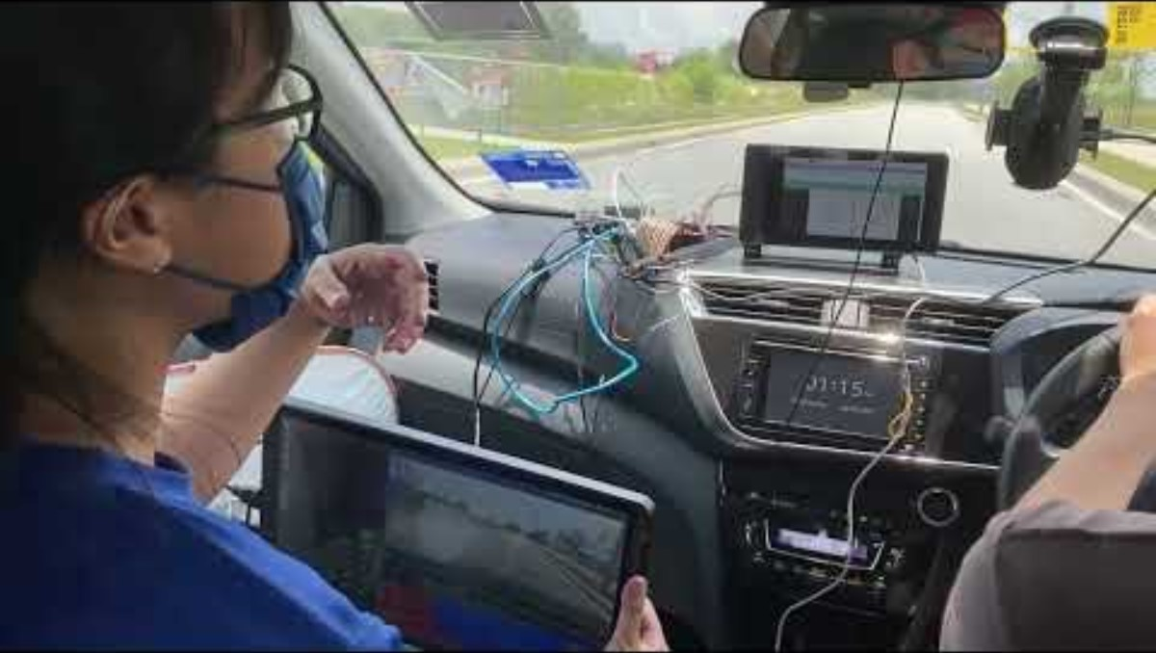
SHORT VIDEO
BATCH 2
PAGE 4

Slide 5
ABSTRACT
Road surface irregularities like potholes present major risks to vehicle safety, passenger comfort, and the efficiency of traffic flow. These issues have significant implications in the transportation domain, as they directly affect road safety, traffic management, and overall driving experience. With the growth of autonomous vehicles and smart city initiatives, the need for intelligent systems that can accurately detect and analyze road conditions in real time has become increasingly important.
Traditional approaches for pothole detection have been enhanced through the integration of computer vision and artificial intelligence. These systems utilize cameras to capture road images, which are then processed using deep learning models to detect and classify potholes. By applying AI-based image analysis, the existing methods effectively automate the identification of road surface irregularities, offering a faster and more efficient alternative to manual inspections and sensor-based techniques.
The limitation in existing systems is their reliance on two-dimensional bounding boxes or simple classification, which lack depth and shape information. To address this limitation, my project proposes a Real-Time Wireframe Pothole Detection System that generates a three-dimensional wireframe of road surfaces using camera input. The proposed model aims to integrate depth estimation with wireframe modeling for precise analysis of surface irregularities, enabling better decisions for autonomous vehicles and improving road safety.
BATCH 2
PAGE 5

Slide 6

objective
WHY AM I DOING THIS PROJECT?
Existing AV systems fail on irregular roads common in developing countries. Potholes and surface deformities pose major safety and comfort issues. High-end LiDAR-based systems are too expensive for mass adoption. Need for a cost-effective, vision-only solution for real-time road anomaly detection.
HOW?
Use a monocular RGB camera to capture continuous road footage. Apply YOLOv8 for anomaly detection and Multiple Depth Estimation Accuracy with Single Network MiDaS for depth estimation. Build a 3D mesh of the road using Open3D to estimate pothole size and depth. Integrate a decision engine for autonomous responses like slowing or avoidance.
TARGET AUDIENCE
Autonomous vehicle developers seeking low-cost perception solutions.
Road and transport authorities for automated road condition monitoring.
Fleet operators aiming to improve safety and reduce maintenance costs.
Researchers and innovators in AI-based smart mobility systems.
BATCH 2
PAGE 6

Slide 7
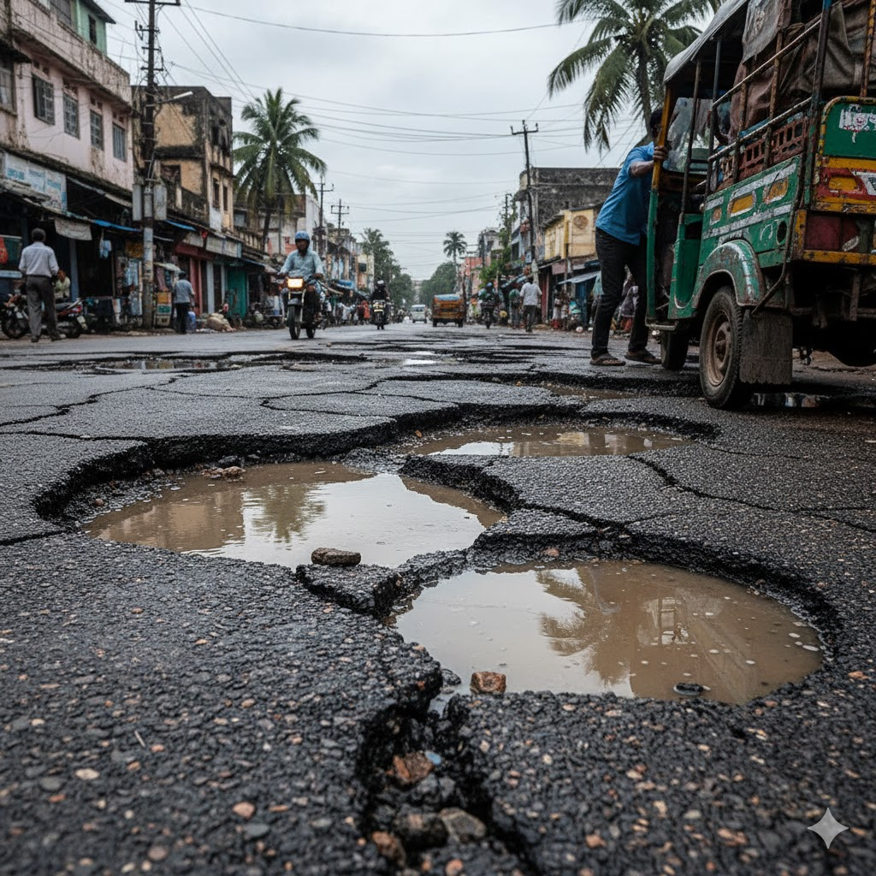
introduction
Autonomous vehicles (AVs) rely on object detection and navigation systems optimized for structured and well-maintained roads. In countries like India, road infrastructure is often inconsistent, featuring frequent potholes, speed bumps, and surface deformities. Standard AV systems struggle to operate reliably in such conditions, impacting safety and ride quality. Surface anomalies reduce ride comfort and can be significant safety hazards. Conventional solutions using LiDAR and high-end sensors are expensive and not suitable for mass deployment. There is a pressing need for a cost-effective, camera-based solution capable of detecting, analyzing, and responding to road surface anomalies in real-time.
BATCH 2
PAGE 7

Slide 8
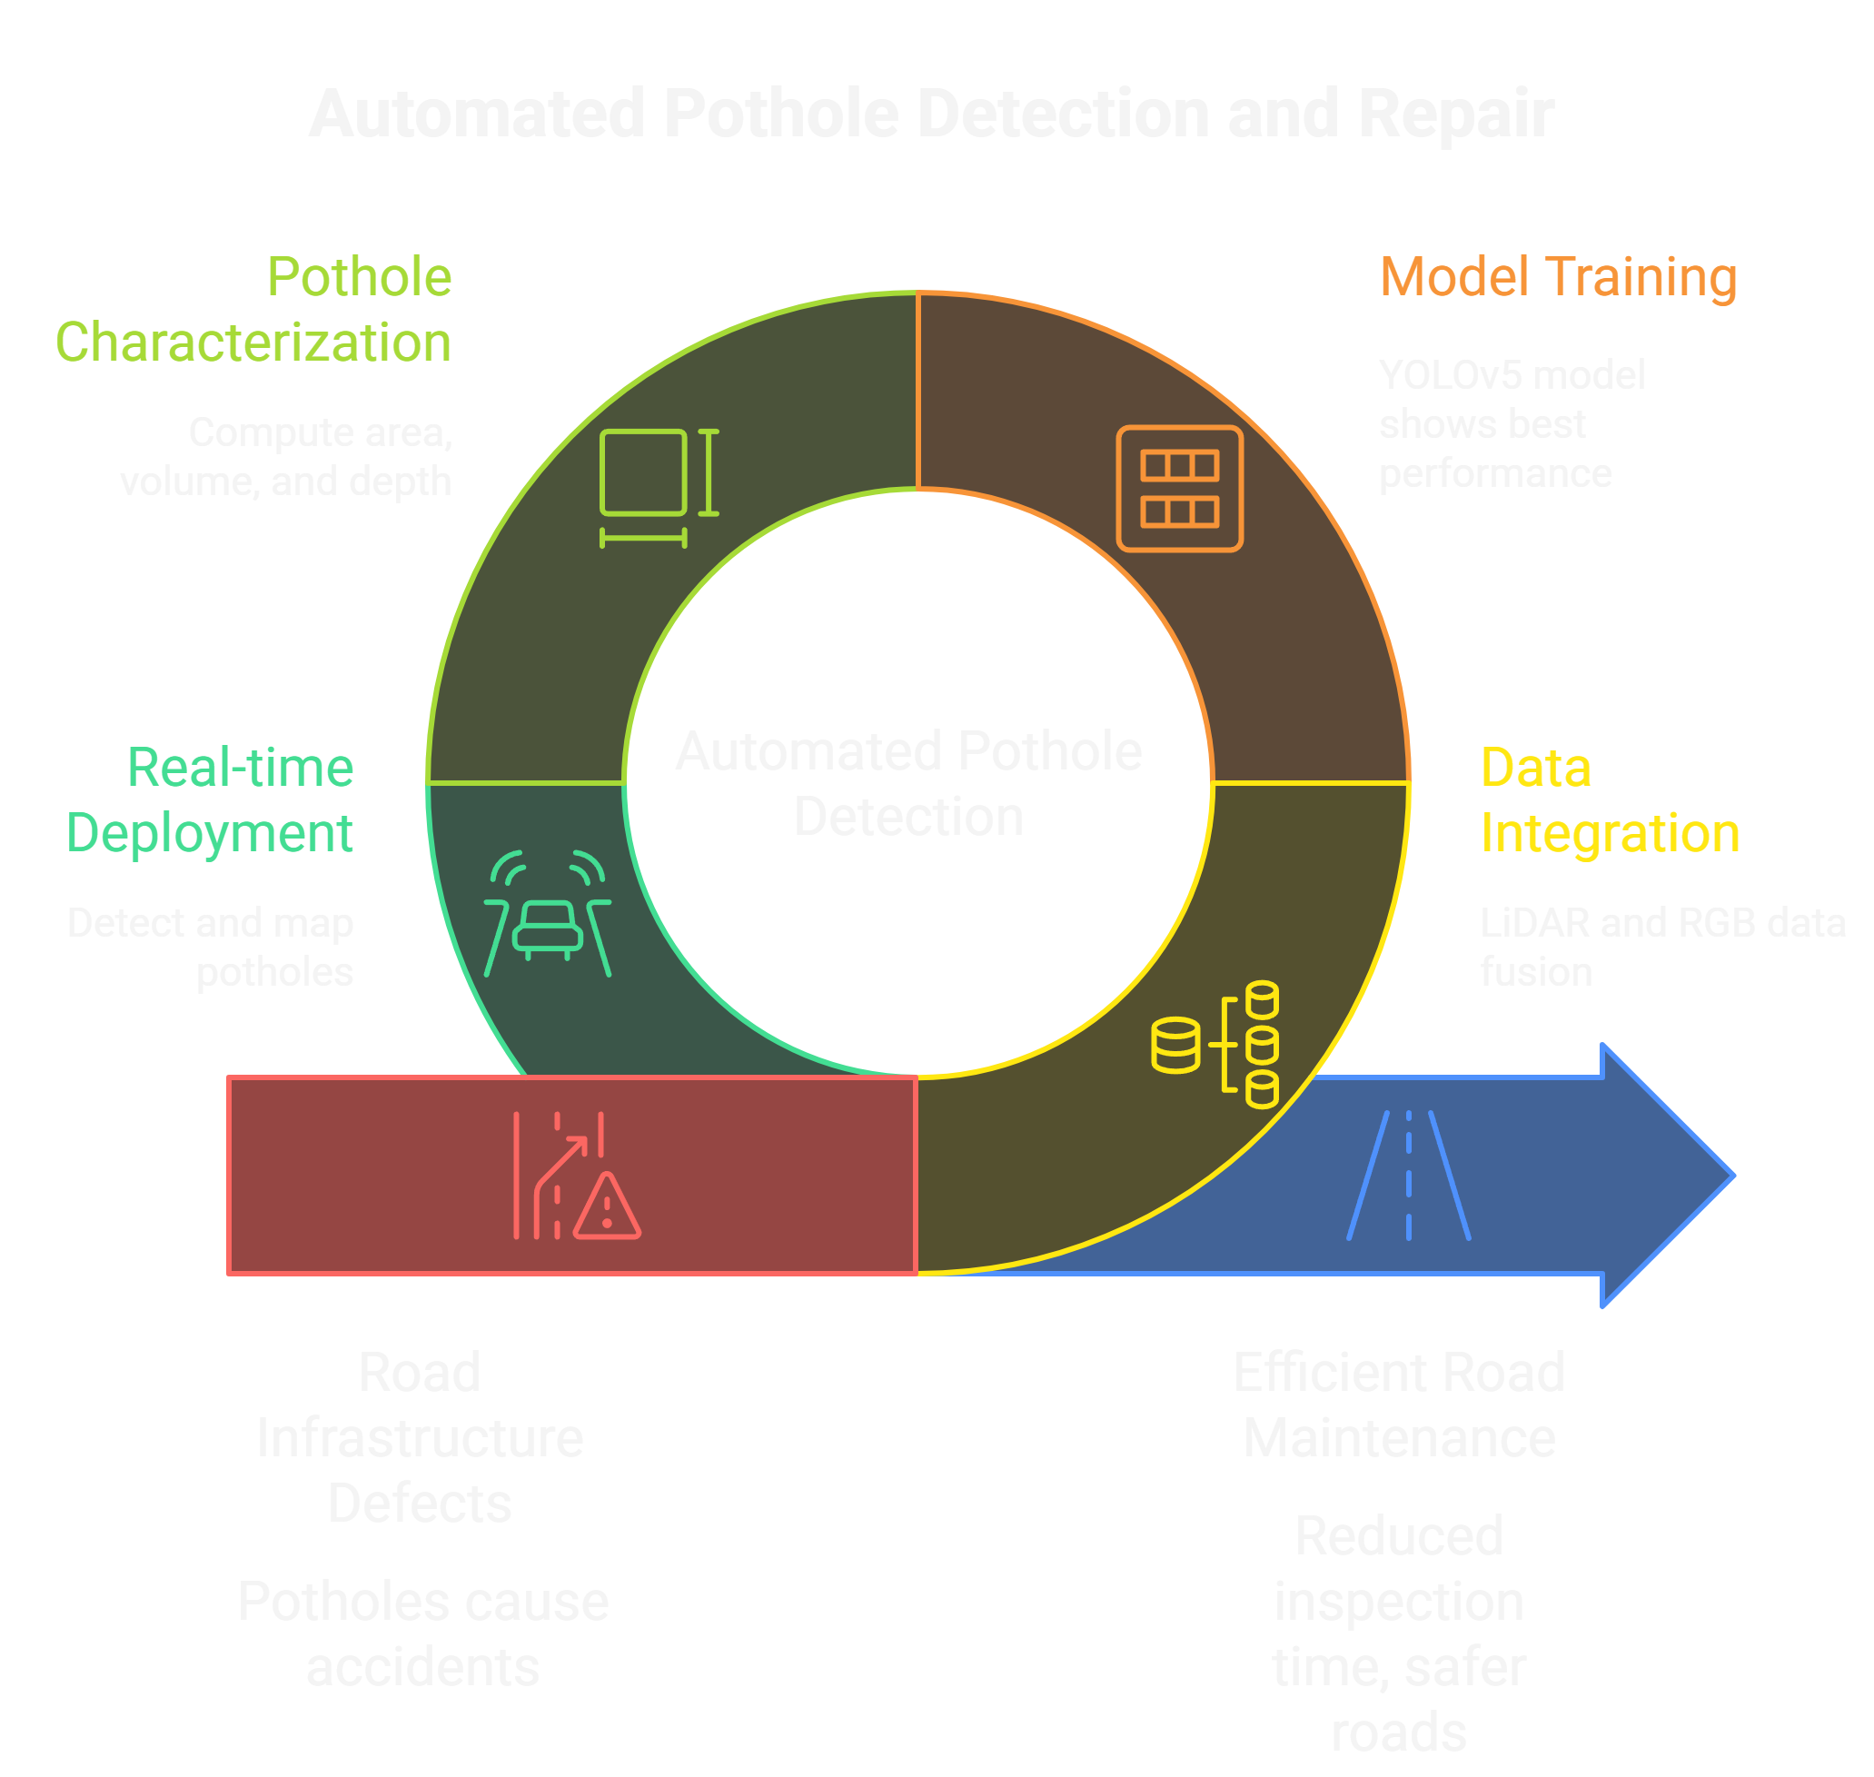
EXISTING SYSTEM
LiDAR + Camera fusion for accurate depth
YOLO object detection
3D LiDAR depth analysis
GNSS-based geo-positioning to automatically detect, measure, and map potholes.
This eliminates manual road inspection and improves both accuracy and maintenance efficiency.
Generates 3D point cloud data for area, volume, and depth analysis
Point cloud and Convex Hull for geometry
BATCH 2
PAGE 8

Slide 9
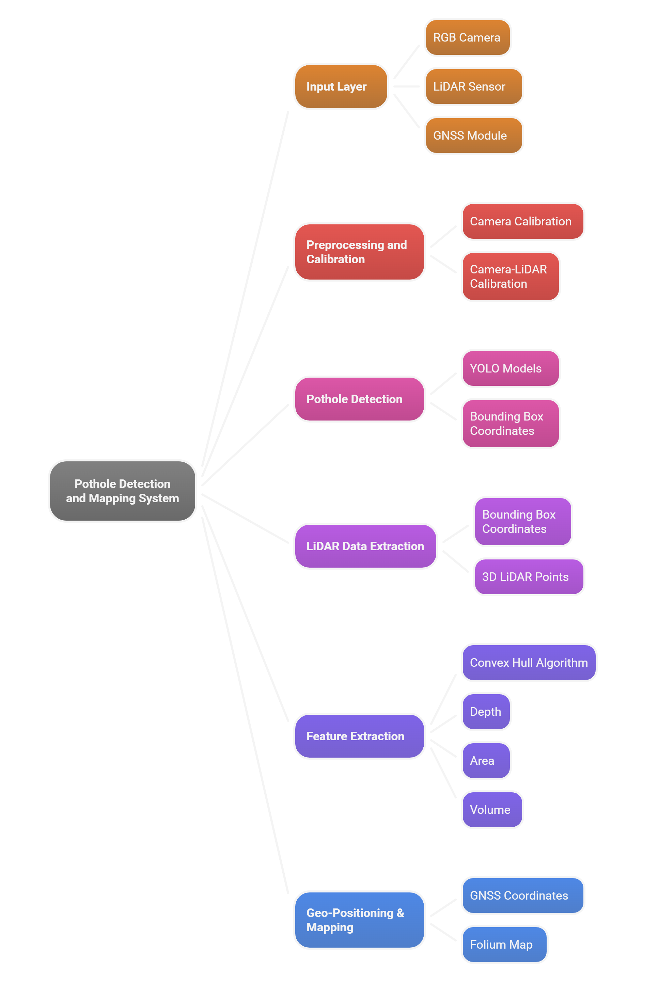
Existing system architecture
BATCH 2
PAGE 9

Slide 10

ADVANTAGES AND DISADVANTAGES
ADVANTAGES
High Detection Accuracy (86%) and Reliability
Integration of Vision and LiDAR (2D + 3D Fusion)
Real-Time and Automated Operation
Automated feature extraction (area, volume, depth) via Convex Hull
GNSS-Based Geo-Mapping and Visualization
Robustness Across Lighting and Environmental Conditions
DISADVANTAGES
High hardware cost due to LiDAR integration
LiDAR accuracy drops when potholes contain water or reflective surfaces
System requires good calibration and synchronization between sensors
Computationally heavy for low-power embedded systems
BATCH 2
PAGE 10

Slide 11
PROBLEM STATEMENT
Although the existing vision–LiDAR integrated pothole detection system demonstrates high accuracy and automation, its practical deployment remains limited due to several constraints. The high cost of LiDAR sensors, the reduced accuracy in wet or reflective conditions, and the requirement for precise sensor calibration and synchronization make the system less feasible for large-scale or real-time use on low-cost platforms. Additionally, the computational demands of fusing LiDAR and deep learning data restrict deployment on resource-constrained embedded devices. Therefore, there is a critical need for a cost-effective, lightweight, and robust pothole detection system capable of maintaining high accuracy using vision-only or minimal-sensor approaches, adaptable to real-world environmental and hardware limitations.
BATCH 2
PAGE 11

Slide 12
LITERTURE SURVEY
BATCH - 02
PAPER 1
TITLE: An Enhanced YOLOv8 Model for Real-Time and Accurate Pothole Detection and Measurement
INTRODUCTION:
Potholes are a major form of road surface damage caused by water infiltration, heavy traffic, and weather conditions, posing serious risks to vehicles and road users. Traditional manual inspection methods are slow, costly, and prone to human error. To overcome these limitations, AI- and vision-based detection systems offer faster, more accurate, and cost-effective solutions. Technologies such as LiDAR, stereo cameras, and deep learning models enable automated pothole identification and measurement, improving maintenance efficiency and road safety.
CONCLUSION:
They created the PothRGBD RGB-D dataset and proposed a lightweight YOLOv8n-seg variant that improves segmentation and enables accurate perimeter & depth estimation. Therefore, I can conclude from their paper that integrating DSConv and SimAM into a YOLOv8 segmentation yields more accurate pothole masks and reliable physical measurements, which I can apply to my pothole detection project to get precise segmentation masks and direct depth/perimeter estimates.
BATCH 2
PAGE 12

Slide 13
LITERTURE SURVEY
BATCH - 02
PAPER 2
TITLE: Robust Video Based Pothole Detection and Area Estimation for Intelligent Vehicles with Depth Map and Kalman Smoothing
INTRODUCTION:
Autonomous driving systems require precise road perception for safety and comfort, but potholes remain a major challenge. Existing LiDAR-based methods are accurate but costly, while vision-only approaches struggle with lighting and angle variations. To address this, a robust vision-based framework is proposed using ACSH-YOLOv8 for detection, DepthAnything V2 for depth estimation, and a Minimum Bounding Triangulated Pixel (MBTP) method for accurate area measurement. A CDKF-based Kalman Filter enhances stability across video frames, ensuring reliable pothole detection and area estimation in real-world conditions.
CONCLUSION:
They present an end-to-end vision pipeline to achieve accurate and stable pothole area estimation from video frames. I conclude from their paper that integrating enhanced object detection, monocular depth estimation, pixel-level area computation, and Kalman-based smoothing can significantly improve the precision and reliability of pothole detection.
BATCH 2
PAGE 13

Slide 14
LITERTURE SURVEY
BATCH - 02
PAPER 3
TITLE: Mobile3DRecon: Real-time Monocular 3D Reconstruction on a Mobile Phone
INTRODUCTION:
Augmented Reality (AR) requires accurate 3D reconstruction to achieve realistic integration of virtual objects with real environments. Existing systems like Kinectic Fusion and Bundle Fusion depend on RGB-D cameras and high computational power, making them unsuitable for mid-range mobile devices. To address this, the Mobile3DRecon system enables real-time dense 3D surface reconstruction using only a monocular camera, without extra sensors. It introduces multi-view depth estimation and incremental mesh generation, allowing seamless, real-time AR performance on standard mobile platforms.
CONCLUSION:
They presented a mobile system capable of generating dense, real time 3D surface meshes using only an embedded monocular camera. They show robust results for AR and object interaction on mid-range phones. Therefore, I can conclude that their mobile-focused, CPU-based incremental mesh generation offers techniques and system design ideas directly applicable to resource-constrained 3D reconstruction tasks like pothole mapping or detection.
BATCH 2
PAGE 14

Slide 15
LITERTURE SURVEY
BATCH - 02
PAPER 4
TITLE: Pothole and Plain Road Classification Using Adaptive Mutation Dipper Throated Optimization and Transfer Learning for Self-Driving Cars.
INTRODUCTION:
Autonomous driving relies on accurate environmental perception to ensure safety, with pothole detection being a critical component. Traditional sensor- and vision-based methods face challenges such as high cost, computational complexity, and limited accuracy under varying conditions. To overcome these, this study proposes a deep learning–based pothole detection system using a convolutional neural network (CNN) for feature extraction and a Random Forest classifier optimized through Adaptive Mutation Dipper Throated Optimization (AMDTO). This approach enhances detection accuracy, robustness, and real-time performance for self-driving vehicles.
CONCLUSION:
This study showed a pipeline that combines transfer-learning feature extraction. Therefore, I can conclude from their paper that applying metaheuristic optimization for feature selection and classifier tuning together with an improved SMOTE balancing step can dramatically boost pothole vs plain-road classification accuracy.
BATCH 2
PAGE 15

Slide 16
LITERTURE SURVEY
BATCH - 02
PAPER 5
TITLE: Real-time scene reconstruction and triangle mesh generation using multiple RGB-D cameras
INTRODUCTION:
3D surface reconstruction and meshing have been extensively studied in computer vision and graphics, with applications in fields like archaeology, cinematography, and robotics. While most work focuses on static scenes, dynamic environments—required in applications like telepresence—pose additional challenges. 3D reconstruction typically involves three stages: data acquisition, surface reconstruction, and geometry extraction. RGB-D sensors enable real-time reconstruction but introduce noise and limited coverage. This work enhances a moving least squares (MLS) surface reconstruction method and generates triangle meshes, a common and view-independent representation in graphics.
CONCLUSION:
They proposed a real-time 3D reconstruction method with a GPU-optimized mesh merging method. They demonstrate both high mesh quality and significant acceleration compared to CPU based methods. I can conclude that their GPU parallel mesh approach, especially the MLS point cloud smoothing and mesh merging, gives insight into achieving fast, reliable surface modeling— knowledge that is valuable for enhancing the efficiency of mesh processing in pothole detection systems.
BATCH 2
PAGE 16

Slide 17
LITERTURE SURVEY TABLE
SL. NO | TITLE | YEAR OF PUBLISHING | TECHNOLOGY USED | CONCLUSION
1 | An Enhanced YOLOv8 Model for Real-Time and Accurate Pothole Detection and Measurement. | 2025 | YOLOv8n-seg, Dynamic Snake Convolution (DSConv), Simple Attention Module (SimAM), GELU activation. | They created the PothRGBD RGB-D dataset and proposed a lightweight YOLOv8n-seg variant that improves segmentation and enables accurate perimeter & depth estimation. Therefore, I can conclude from their paper that integrating DSConv and SimAM into a YOLOv8 segmentation yields more accurate pothole masks and reliable physical measurements, which I can apply to my pothole-detection project to get precise segmentation masks and direct depth/perimeter estimates.
2 | Robust Video-Based Pothole Detection and Area Estimation for Intelligent Vehicles with Depth Map and Kalman Smoothing | 2025 | ACSH-YOLOv8, BoT-SORT, Ego-motion compensation, DepthAnything, MBTP, CDKF (Confidence–Distance Kalman Filter). | They present an end-to-end vision pipeline to achieve accurate and stable pothole area estimation from video frames. I conclude from their paper that integrating enhanced object detection, monocular depth estimation, pixel-level area computation, and Kalman-based smoothing can significantly improve the precision and reliability of pothole detection.
3 | Mobile3DRecon: Real-time Monocular 3D Reconstruction on a Mobile Phone | 2020 | Monocular camera, 6DoF SLAM system, Semi-global matching (SGM), DNN-based depth refinement, Scalable TSDF voxel fusion, Mesh generation algorithm on mobile CPUs. | They presented a mobile system capable of generating dense, real-time 3D surface meshes using only an embedded monocular camera. They show robust results for AR and object interaction on mid-range phones. Therefore, I can conclude that their mobile-focused, CPU-based incremental mesh generation offers techniques and system design ideas directly applicable to resource-constrained 3D reconstruction tasks like pothole mapping or detection.
BATCH 2
PAGE 17

Slide 18
LITERTURE SURVEY TABLE
SL. NO | TITLE | YEAR OF PUBLISHING | TECHNOLOGY USED | CONCLUSION
4 | Pothole and Plain Road Classification Using Adaptive Mutation Dipper Throated Optimization and Transfer Learning for Self-Driving Cars. | 2022 | ResNet-50, Binary Advanced Mutation, Dipper Throated Optimization, Optimized hashing SMOTE, Random Forest (RF), AMDTO optimizer. | This study showed a pipeline that combines transfer-learning feature extraction. Therefore, I can conclude from their paper that applying meta-heuristic optimization for feature selection and classifier tuning together with an improved SMOTE balancing step can dramatically boost pothole vs plain-road classification accuracy.
5 | Real-time scene reconstruction and triangle mesh generation using multiple RGB-D cameras | 2017 | Point cloud smoothing, Mesh zippering, Direct triangle mesh generation, Mesh merging. | They proposed a real-time 3D reconstruction method with a GPU-optimized mesh merging method. They demonstrate both high mesh quality and significant acceleration compared to CPU-based methods. I can conclude that their GPU-parallel mesh approach, especially the MLS point cloud smoothing and mesh merging, gives insight into achieving fast, reliable surface modeling—knowledge that is valuable for enhancing the efficiency of mesh processing in pothole detection systems.
BATCH 2
PAGE 18

Slide 19
PROPOSED SOLUTION
A vision-only, low-cost real-time perception pipeline that generates a 3D wireframe/mesh of the road surface using a single forward-facing monocular RGB camera. The system detects and measures potholes and road anomalies using depth-aware reconstruction.
YOLOv8-Seg / YOLOv8n-Seg for real-time surface anomaly detection with pixel-level segmentation.
MiDaS / DepthAnything V2 for monocular depth prediction to convert 2D detections into metric 3D structures.
Mesh generation using Open3D to create a wireframe representation of the road surface.
Geometry extraction module to compute pothole depth, area, perimeter, and volume.
Decision engine to trigger alerts or safe responses (slow-down, micro-avoidance, logging).
Provides a cost-effective, real-time, sensor-efficient alternative to LiDAR-based systems with strong deployment potential for AVs and road-mapping applications.
BATCH 2
PAGE 19

Slide 20
PROPOSED SYSTEM
The system processes live video input from an onboard monocular camera and converts it into a 3D wireframe model for pothole detection and analysis.
1. Input Capture Continuous RGB frames from the monocular camera mounted on the vehicle.
2. Object Detection & Segmentation YOLOv8 detects potholes, cracks, and bumps with segmentation masks.
3. Depth Estimation MiDaS predicts dense depth maps for each frame.
4. 3D Point Cloud Formation The depth map + segmentation mask is converted into a localized point cloud.
5. Wireframe & Mesh Reconstruction Open3D generates a surface mesh for shape and structure analysis.
6. Pothole Geometry Analysis Depth, width, perimeter, and volume are computed using mesh features.
7. Decision Engine Provides real-time action: slow down, steering adjustment, or event logging.
Purpose To achieve accurate, low-cost, real-time pothole detection suitable for autonomous vehicles and road maintenance authorities.
BATCH 2
PAGE 20

Slide 21
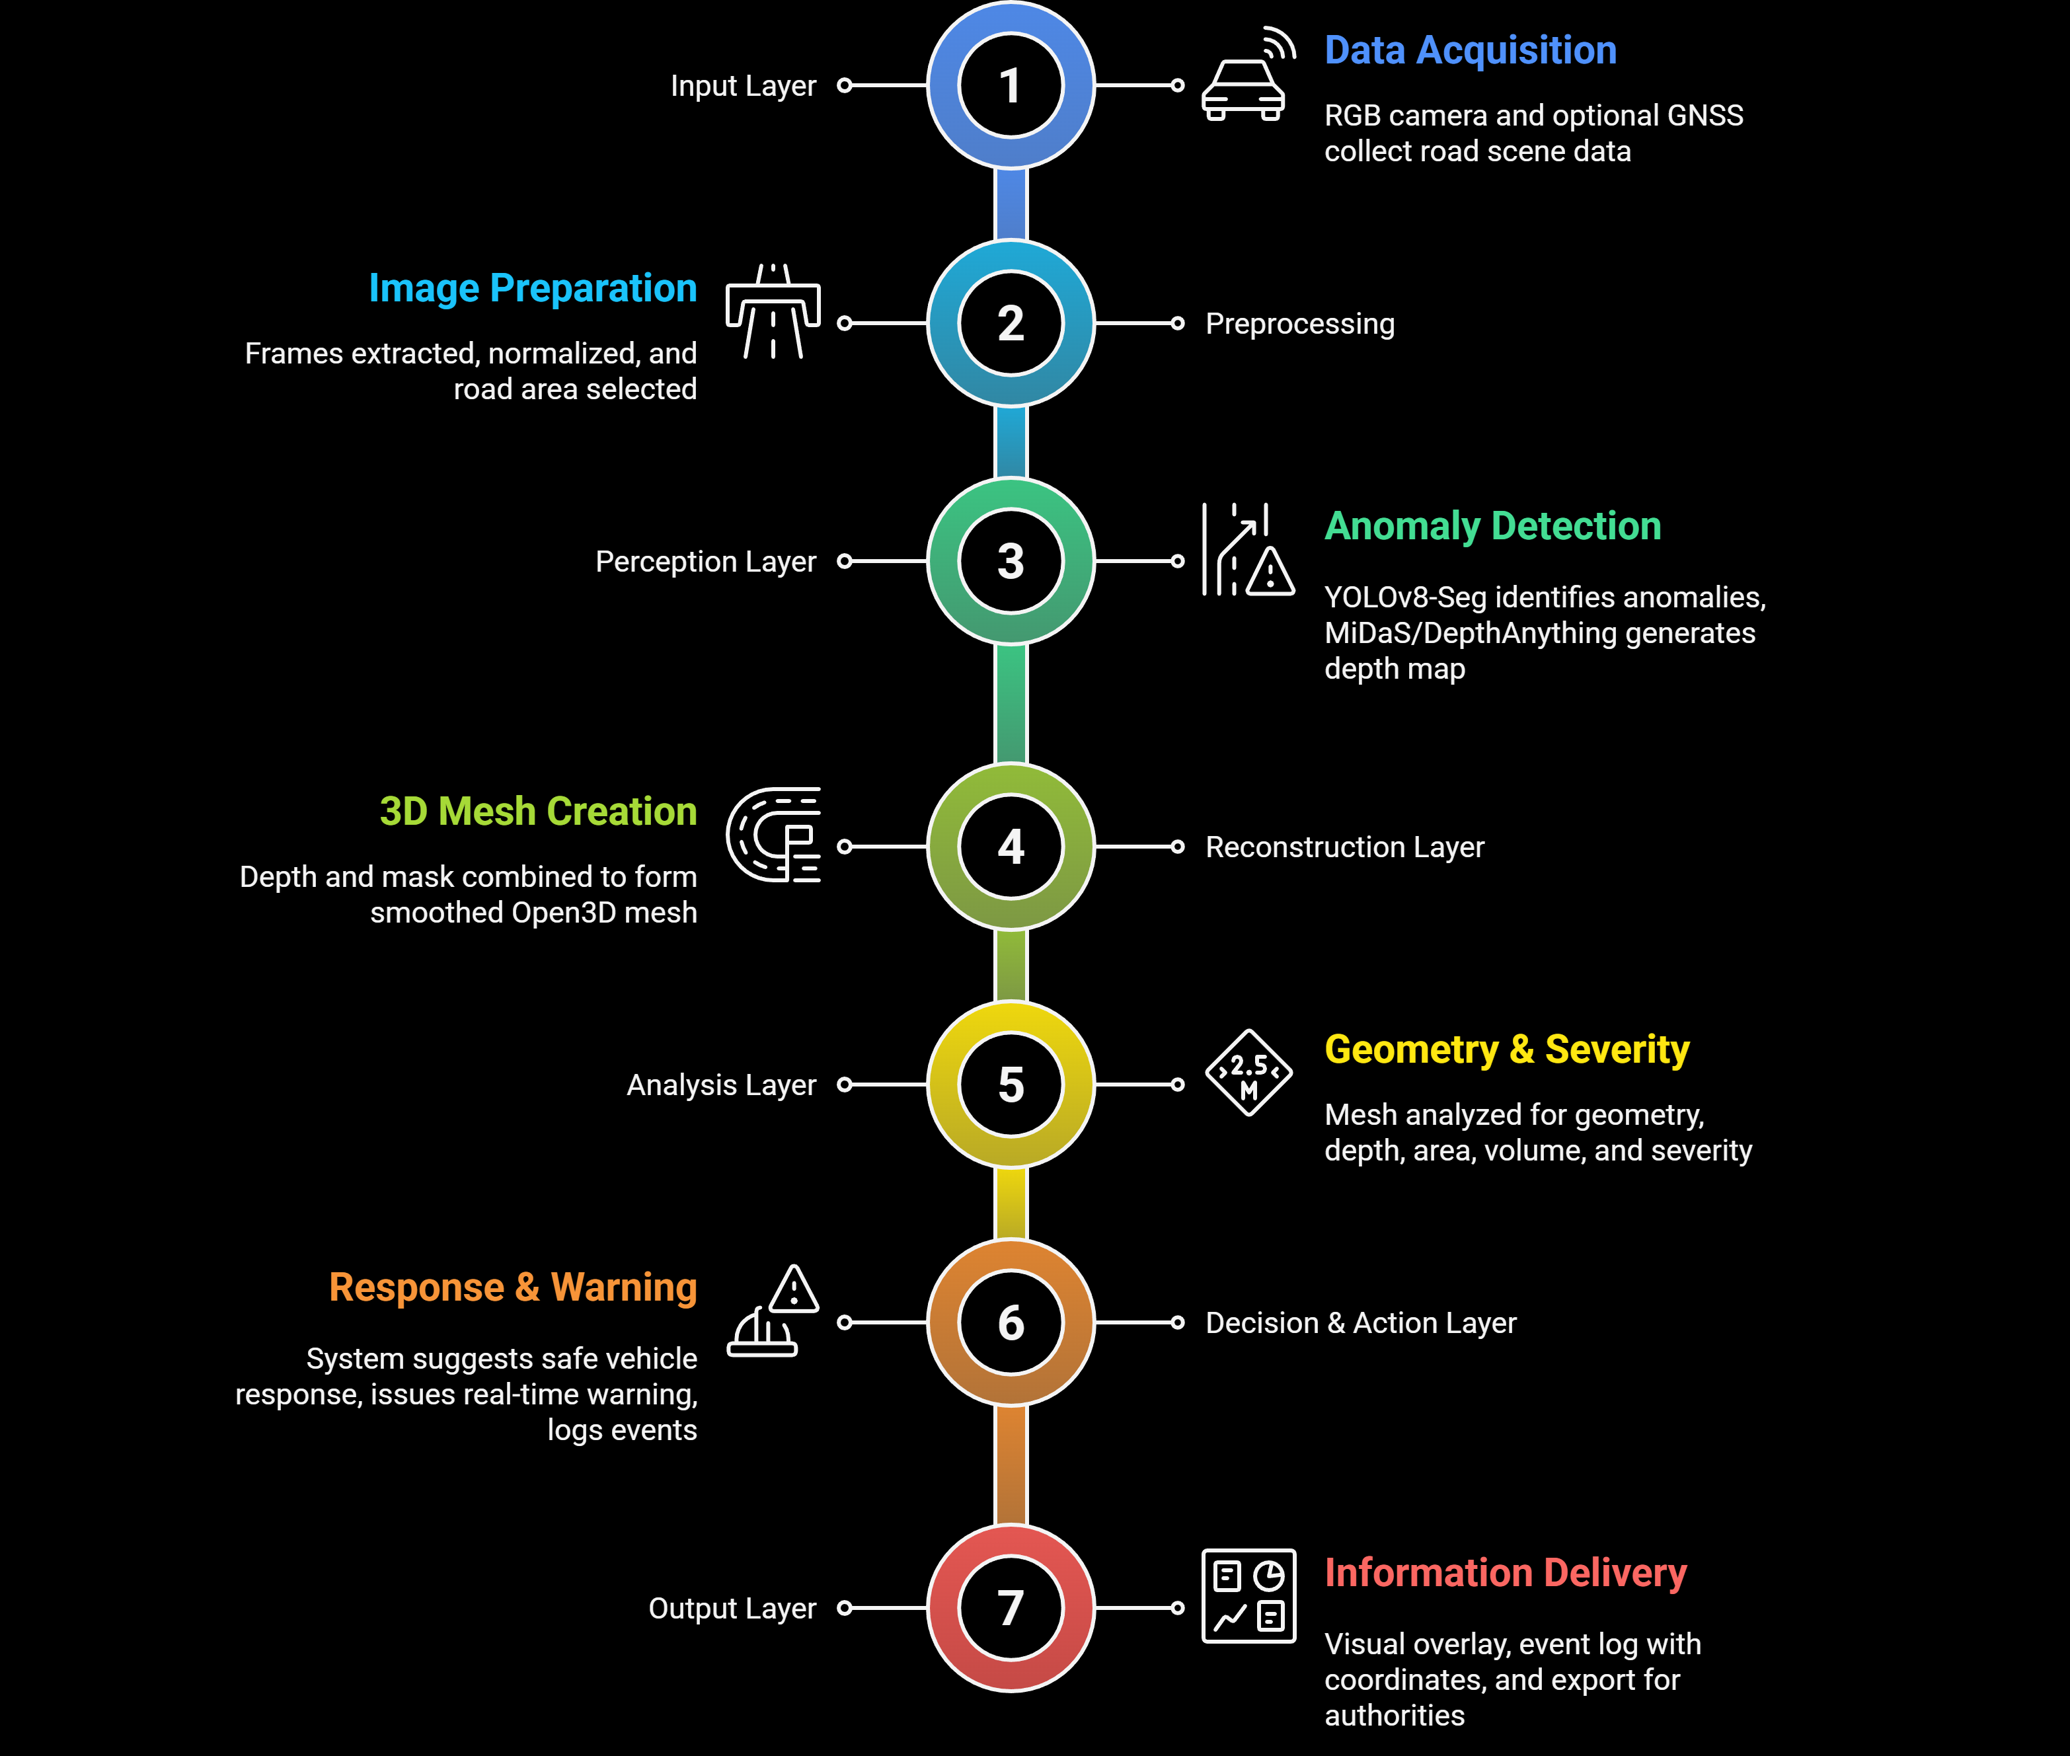
PROPOSED SYSTEM ARCHITECTURE
BATCH 2
PAGE 21

Slide 22
SYSTEM REQUIREMENT
Component | Specification
Camera | Monocular RGB camera, 1080p@30–60 FPS, wide-angle 120° FOV
Processing Unit | NVIDIA Jetson Nano / Xavier NX or Laptop GPU (RTX 3060+)
CPU | Quad-core 2.0 GHz or above
RAM | Minimum 8 GB (Recommended 16 GB)
Storage | 256 GB SSD for datasets + logs
Optional Sensors | GNSS module for mapping pothole locations
Software Requirements
Programming Language: Python 3.10+
Deep Learning Framework: PyTorch
ML Models: YOLOv8-Seg, MiDaS / DepthAnything V2
3D Toolkit: Open3D
Development Tools:
Anaconda / Virtual Environment
Jupyter Notebook / VS Code
CUDA Toolkit (if using NVIDIA GPU)
OS: Ubuntu 20.04/22.04 or Windows 10/11
BATCH 2
PAGE 22

Slide 23
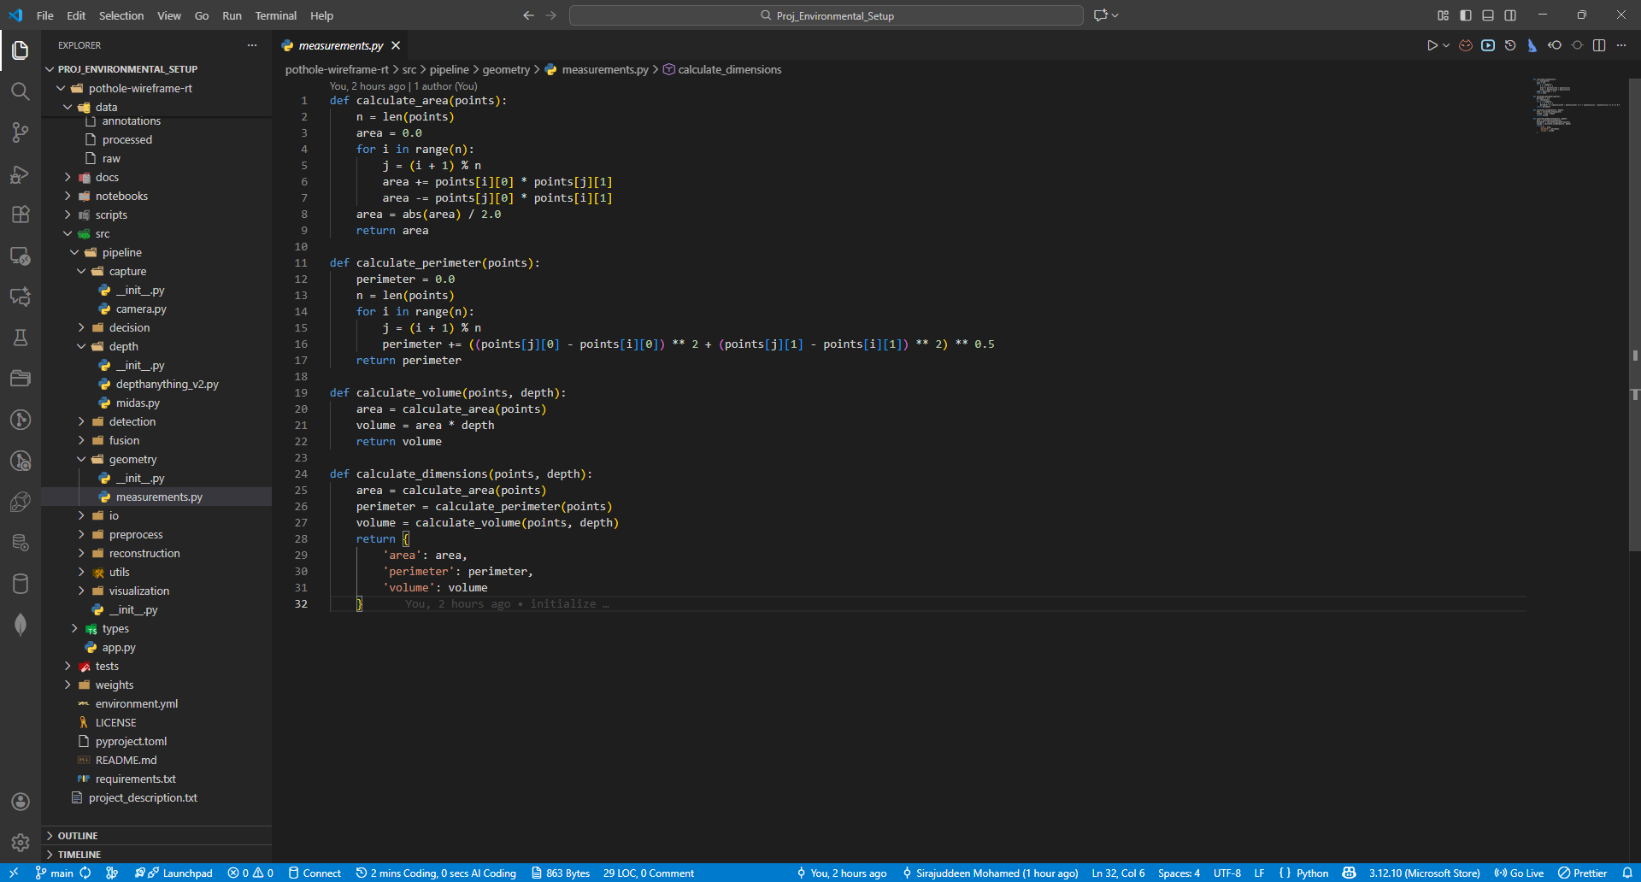
ENVIRONMENTAL SETUP
BATCH 2
PAGE 23

Slide 24

CURRENT STATUS
Selected the base paper for core methodology reference.
Analyzed and understood existing systems and architectures.
Identified the problem statement and real-world constraints.
Completed a detailed literature survey covering detection, depth estimation, and 3D reconstruction.
Identified the technology stack (YOLOv8, MiDaS, Open3D).
Started deep-dive research on the integration of detection + depth + mesh reconstruction pipeline.
Working on refining the design for the proposed system architecture.
Preparing dataset collection and preprocessing plan for upcoming implementation.
BATCH 2
PAGE 24

Slide 25

CONCLUSION
This presentation established a strong foundation for a real-time wireframe-based pothole detection system by analyzing existing solutions, identifying key limitations, and defining a clear problem statement. Through an extensive literature survey, it highlighted advances in vision-based detection, depth estimation, and 3D reconstruction. The proposed solution, system workflow, and architecture outline a cost-effective, monocular camera pipeline using YOLOv8, MiDaS, and Open3D for accurate anomaly detection and geometry analysis. The defined hardware and software requirements provide a complete blueprint for implementation, enabling a structured and scalable path toward developing the final system.
BATCH 2
PAGE 25

Slide 26
REFERENCE
[1] Deep Learning Enhanced Feature Extraction
[2] An Enhanced YOLOv8 Model for Real-Time and Accurate Pothole Detection and Measurement
[3] Robust Video Based Pothole Detection and Area Estimation for Intelligent Vehicles with Depth Map and Kalman Smoothing
[4] Mobile3DRecon: Real-time Monocular 3D Reconstruction on a Mobile Phone
[5] Pothole and Plain Road Classification Using Adaptive Mutation Dipper Throated Optimization and Transfer Learning for Self-Driving Cars.
[6] Real-time scene reconstruction and triangle mesh generation using multiple RGB-D cameras
BATCH 2
PAGE 26

Slide 27
Thank You
BATCH 2
PAGE 27

